Slide 1
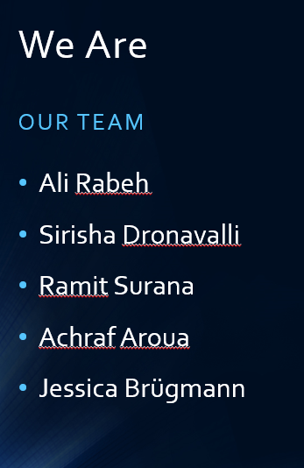
SIEMENS BUSINESS CHALLENGE
TEAM: JAARSX

Slide 2
CONTENTS
Problem
Value Proposition
OPENAI Capabilities
Recommendations

Slide 3
PROBLEM
•Companys often face an Email clutter which takes up a lot of time.
•The important information is often hard to get out of the content.
•Therefore much time and human resource are used uneffectively for the task of managing this issue.

Slide 4
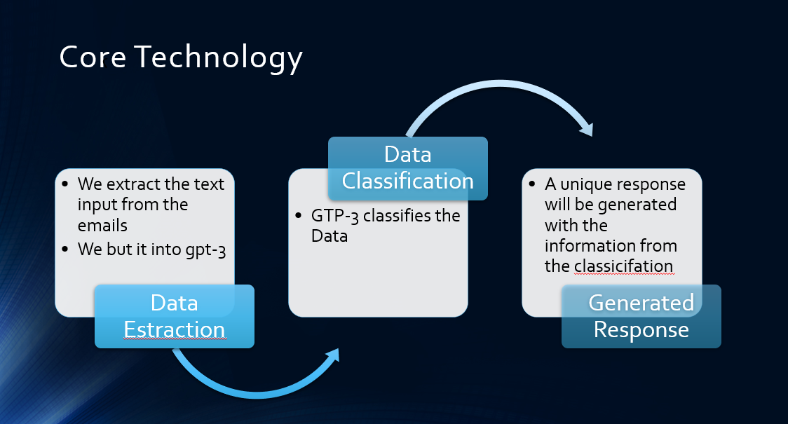

Slide 5
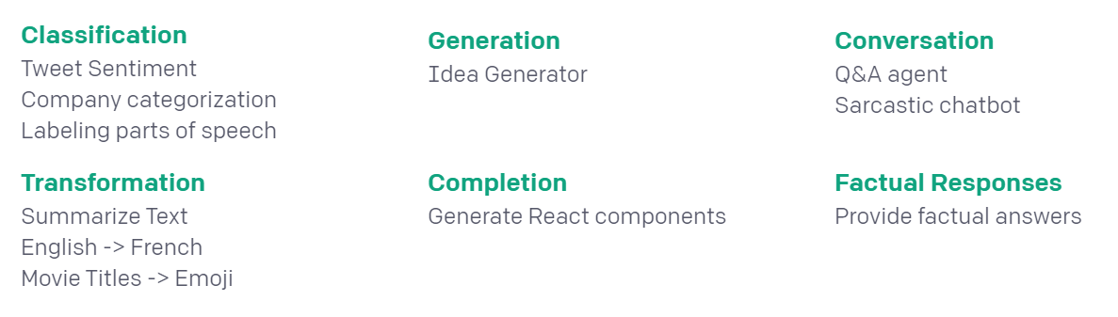
OPENAI CAPABILITIES
There are three concepts that are core to the API: prompt, completion, and tokens.
The “prompt” is text input to the API, and the “completion” is the text that the API generates based on the prompt.

Slide 6




OPENAI ENGINES
Finding the right engine

Slide 7
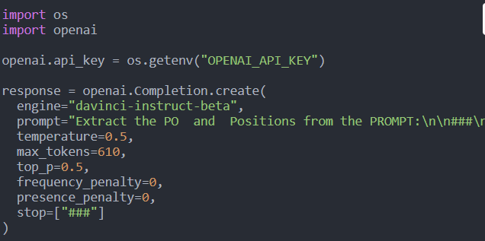
RECOMMENDATIONS
COMPLETIONS
Given a prompt, the model will return one or more predicted completions, and can also return the probabilities of alternative tokens at each position.

Slide 8
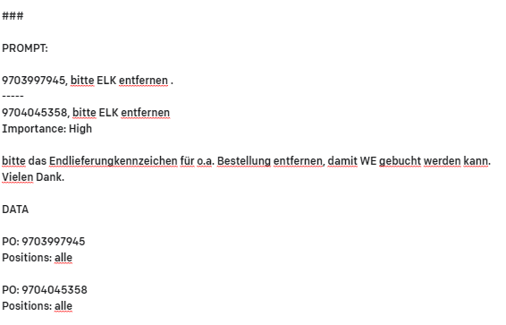

Slide 9

BUSINESS MODEL
how do you want to make money?
whom do you sell to?
does customer = user?

Slide 10
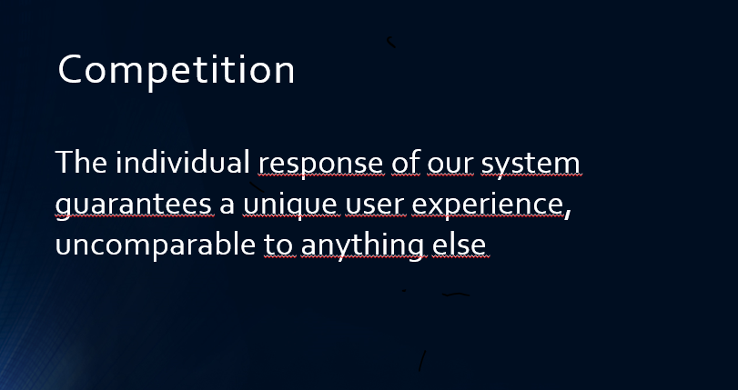
COMPETITION
how do you want to differentiate?
what other solutions do customers use now?

Slide 11
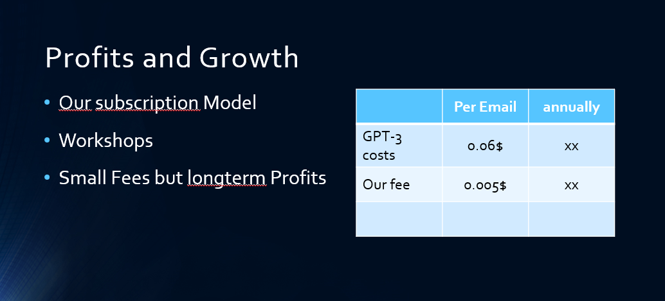
TEAM
why you?
what’s your unfair advantage?
which partners/mentors support you?

Slide 12


